Slide 1
Protecting the Perimeter: Insights into Cybersecurity, Honeypots, and Facebook Security
A Presentation by: Paul Haithcock – cyber range cloud administrator –For cyber range Poulsbo – Washington state educational cyber range

Slide 2
Cybersecurity landscape overview
In today's interconnected digital world, cybersecurity threats are pervasive and constantly evolving. Organizations face a multitude of cyberattacks ranging from phishing and malware to advanced persistent threats (APTs) and ransomware. These threats can result in financial losses, reputational damage, and operational disruptions.

Slide 3
What is cybersecurity?
Cybersecurity is the art of protecting networks, devices, and data from unauthorized access or criminal use and the practice of ensuring confidentiality, integrity, and availability of information. – Cybersecurity and Infrastructure Security Agency (CISA)
Notes:
This is an opener – talk about what we do at the cyber range to help teach and expand knowledge of cyber security with universities, schools, and the community.

Slide 4
Introduction to Facebook Security
With billions of users worldwide, Facebook is a prime target for cybercriminals. Ensuring the security and privacy of its platform is paramount for maintaining user trust and confidence. Facebook users can fall victim to various types of cyberattacks, including:
Phishing: Attackers create fake login pages or send deceptive messages to trick users into disclosing their login credentials.
Malware Attacks: Users may inadvertently download malware disguised as legitimate software or links, compromising their accounts and devices.
Account Takeovers: Weak passwords or password reuse across multiple accounts can lead to unauthorized access to Facebook accounts.
Identity Theft: Cybercriminals may steal personal information from compromised accounts to impersonate users or conduct fraudulent activities.
Privacy Breaches: Misconfigured privacy settings or unauthorized access to account information can result in privacy violations and data exposure.
Notes:
Facebook help center – about phishing https://www.facebook.com/help/166863010078512?helpref=faq_content

Slide 5
Keeping your Facebook secure
Don’t accept friend requests from people you do not know.
Never click suspicious links even if they come from a friend or company, you know
Never participate in posts that ask for personal information or “slambooks” on Facebook.
Set up two factor authentication
Notes:
Slambooks - https://giveitgetit.org/social-media-questions/ - Link explaining in detail why this is a security issue. Notes below.
Do you remember the name of your first grade teacher?
What was your first car?
What street did you grow up on?
What was your first pet’s name?
These questions seem harmless, and for the vast majority of social media users, they are. Unfortunately, millions of criminals lurk Facebook, Twitter, and Instagram, looking for personal information they can use against you. Every time you answer a question on Facebook that asks for personal information, you put yourself at risk for identity theft or sophisticated scams.
Facebook help center - https://www.facebook.com/help/213481848684090
Use our extra security options
You can also get alerts about unrecognized logins, and set up two-factor authentication.
If you're logged into Facebook on a computer, you can use Security Checkup to review your security settings.
Never click suspicious links, even if they appear to come from a friend or a company you know
This includes links on Facebook (example: on posts) or in emails.
Keep in mind that Meta will never ask you for your password in an email.
If you see a suspicious link on Facebook, report it.
Log out of Facebook when you use a computer you share with other people
If you forget, you can log out remotely.

Slide 6
Why are facebook accounts hacked?
To steal personal information: Hackers can use your personal information to commit identity theft or other crimes.
To send spam or malware: Hackers can use your account to send spam messages or malware to your friends and followers.
To hold your account hostage: Hackers may lock you out of your account and demand a ransom to unlock it.
To damage your reputation: Hackers may post embarrassing or offensive content on your account, which can damage your reputation.
Notes:
Hackers will use older established accounts to gain access to the account. Then change all the personal information so they can use the account to sign up for other services. Think an older more established account may be more trusted than a brand new account.
Hackers will use accounts for scams. They will chat up your contacts/friends and present them with scams. Hackers also will take older accounts and sell them to other hackers to be used in nefarious conducts. Making money by selling your account.

Slide 7
What can happen if my computer is hacked or infected by malware?
Computer turned into a Zombie (Become part of a BotNet)
Used in mass email spam campaigns
Steal your information and use this information to propagate malware to your contacts.
Notes:
Malware can do a lot of things to your computer. Some more malicious than others. At its simplest Malware just serves ads and can route you to websites that want to sell you a service. At the worst they can turn your computer into a Zombie which allows a cyber criminal to use your computer for all sorts of malicious activities such as DDoS attacks.
Your information can be stolen, such as your password to your email account. Then using your email they can send emails to your contacts who may be more likely to trust a malicious link sent from one of their contacts that can then lead to them being compromised as well.

Slide 8
Some signs you have been compromised…
Frequent pop-up windows
Mass emails being sent from your email account
Frequent crashes or unusually slow computer performance
Unknown programs that startup when you start your computer
Passwords being changed and you did not do it

Slide 9
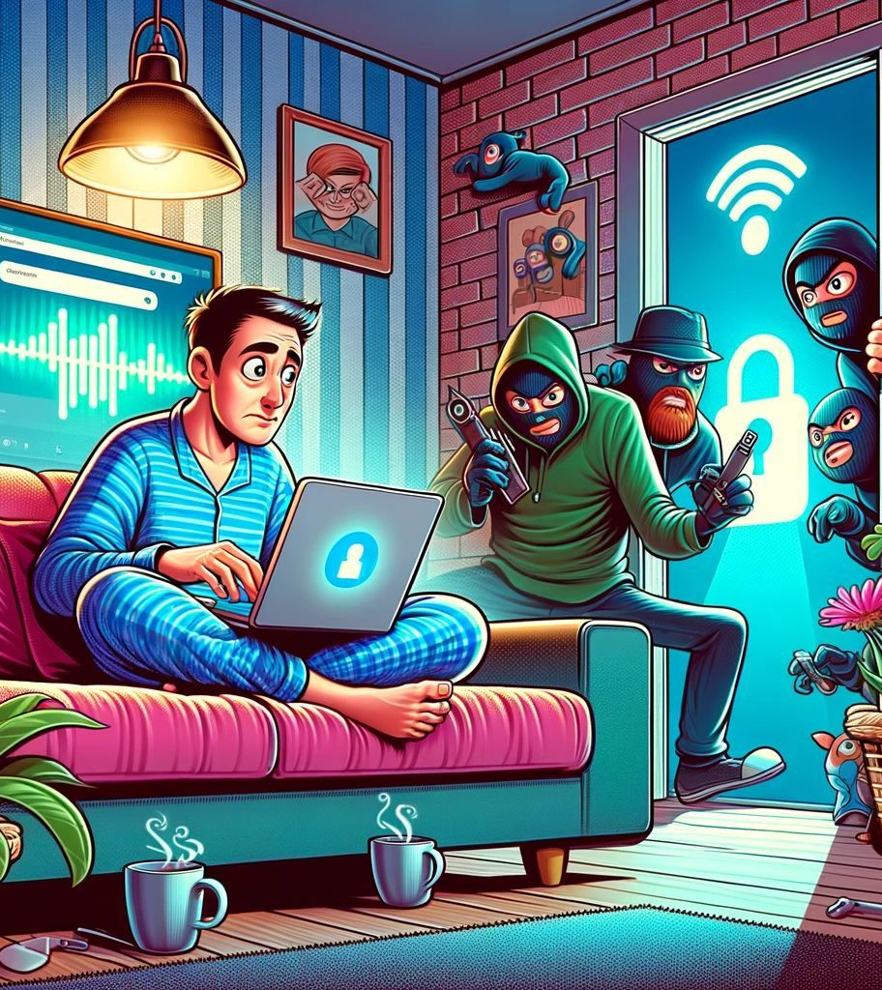
What does that mean for you? How can you protect yourself?
It is important for all users to protect themselves from security threats.
Protect yourself from Malware
Secure your personal data
Practice safe internet habits
Awareness and Education
Notes:
Protect yourself from Malware – Use a good Antivirus software. Something that includes firewall and real time protection – I.E. – Norton. But be aware that Antivirus software are only as good as their virus definitions. Ensure you are not going to unsafe sites. If a site asks you to download something in order to get to the information you are looking for it may be malware/spyware.
Secure your personal data – Never enter your personal information into any site that is not secure I.E- HTTPS. Ensure you are only giving your information to sites you trust. Use strong passwords, do not use personal identifying data, if random characters and numbers are not your thing use sentences that mean something to you. Be wary of password vaults – think Last Pass.
Practice Safe internet habits – Only go to reputable sites. If you’re looking to get something for free I.E. – Movies, software, music. You run the risk of getting hacked. Make backups of your data regularly, if something seems off it most likely is. Never trust anything that you did not do yourself. Such as a pop up from a website saying you are infected. If it did not come from your paid antivirus or Microsoft Defender it could be a scam. Keep your PC and Devices up to date. Setting up 2 factor authentication for your financial accounts is a good idea.
Awareness and Education – Keep up on security news – Krebs On security @BrianKrebs, Cybersecurity blogs – PCWorld, Infosecurity Magazine, Be aware of who has your information and what they are using it for. Be mindful of granting rights to applications on your PC or Phone, websites and any other application. https://haveibeenpwned.com/
https://krebsonsecurity.com/
https://www.pcworld.com/security
https://www.infosecurity-magazine.com/

Slide 10
Helpful sites
https://krebsonsecurity.com/
https://www.pcworld.com/security
https://www.infosecurity-magazine.com/
Facebook Account Security - https://www.facebook.com/help/166863010078512?helpref=faq_content
Facebook Phishing Information - https://www.facebook.com/help/166863010078512?helpref=faq_content

Slide 11
Introduction to Honeypots as a Proactive Defense Mechanism
Honeypots represent a proactive approach to cybersecurity defense. Unlike traditional defensive measures that focus on perimeter security and reactive incident response, honeypots are strategically deployed to attract and deceive attackers. By luring attackers into engaging with simulated systems and services, honeypots provide valuable insights into their tactics, techniques, and procedures (TTPs), allowing organizations to better understand and mitigate potential threats.
Notes:
Our honeypot infrastructure uses TPOT CE. It is a self contained environment that uses multiple honeypots to collect a wide range of data. This honeypot also uses Kibana to aggregate the data so that it is easily searchable. This is what is powerful for our students. They can learn about real time attacks that are happening now and gain a better understanding of what these attacks are doing.

Slide 12
What does the Cyber Range Use Honeypots for?
Cyber Range Poulsbo is in a unique position to host a honeypot that can be used for educational purposes. By using our own infrastructure and good security practices we allow schools and students to interact with a live honeypot and gaining relevant security operations center (SOC) experience they could not get anywhere else.
Find out more about the Cyber Range Honeypots: https://window.wwu.edu/sweetening-pot
Notes:
Instructors from multiple colleges use our Honeypot to help train future SOC analysts. This works well with our partner relationship with the Public Infrastructure Security Cyber Education (PISCES) program.

Slide 13
Cyber Range Honeypot Demo

Slide 14
Questions?

Slide 15
Thank you!
Contact Information
Paul Haithcock
Cyber Range Cloud Administrator
Email: Paul.Haithcock@wwu.edu

